Slide 1
Shark Movement Modelling using State Space Models
Madelyne Zhang , Leo Lyu
Supervisor: Vianey Leos Barajas
University of Toronto
Notes:
Good morning everyone. Today we’ll be presenting our project on shark movement modelling using state-space models. This is an ongoing project and the goal of this presentation is to walk through our current modelling framework and show some preliminary results.
Today’s talk is structured as follows: We begin with the research questions and data, then introduce the state-space and movement persistence models. We then outline our analytical workflow, followed by visualizations and preliminary results, and conclude with current limitations and next steps.

Slide 2
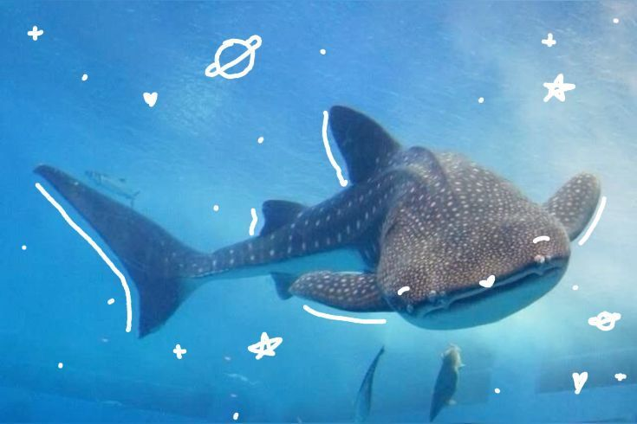
Research Question
How can latent whale shark movement be inferred from noisy and irregular telemetry data?
How is movement persistence associated with environmental covariates?
Data Description
Spatio-temporal Argos telemetry data from 60 tagged whale sharks from (2011-2021)
Irregular observation times with heterogeneous measurement error
Locations recorded as latitude-longitude with Argos Error classes
Notes:
We frame the project around two main questions.
First, how to infer latent whale shark movement from noisy and irregular telemetry data.
Second, how movement persistence is associated with environmental covariates.
The data consist of spatio-temporal Argos telemetry from 60 tagged whale sharks collected between 2011 and 2021.
Observations are irregular in time and subject to heterogeneous measurement error, with locations recorded as latitude–longitude and associated Argos error classes.
These data characteristics naturally motivate a state-space modelling framework.

Slide 3
Why State-Space Models (SSM)?
State Space Model (SSM)
SSM (State-Space Model) deal with time-series data with hidden “true states” :
  State model: how true system changes over time (true position of sharks).
  Observation model: how the data are generated from the true state, with measurement error
To estimate the hidden true states and uncertainty, using noisy observations.
Observed tracking locations are noisy and incomplete
True animal movement occurs continuously in time
Notes:
/ NOTTTTTT MINEEEE/
To begin with, let’s first introduce the state-space model.
…..
In our scenario for building the model, we make the true location of the shark the hidden state, and the observed location is the observation generated from the hidden state.

Slide 4
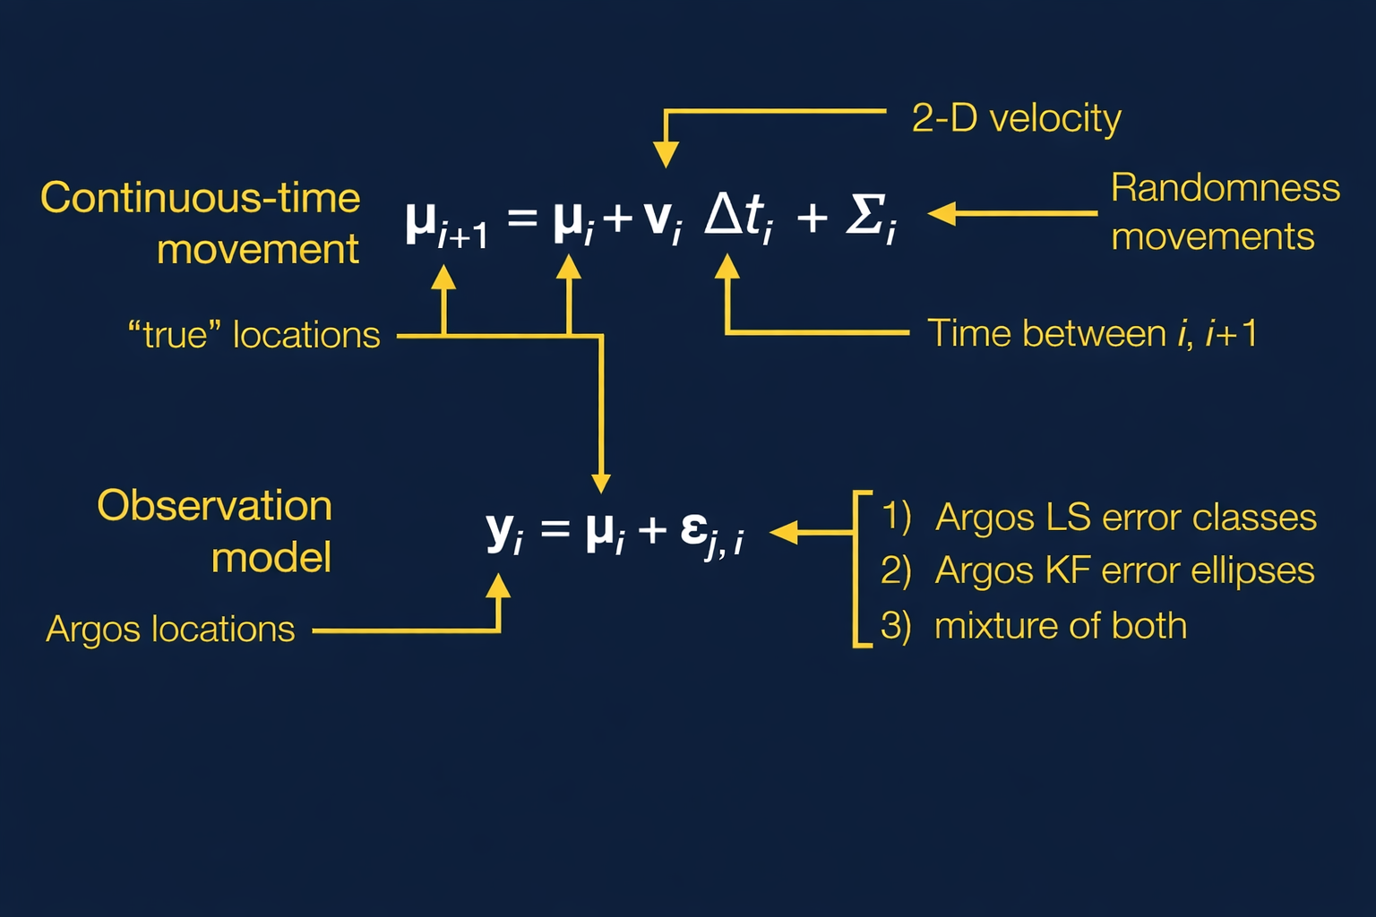
Move Persistence Model (MPM)
State Space Model:
MPM is a specific state-space Model that parametrizes movement persistence
Move Persistence Model
vₜ = γₜvₜ₋₁ + ηₜ , γₜ ∈ (0, 1)
Notes:
// NOTTTTTT MINEEEE/
Let’s go through the formula for the state-space model, and specifically, introduce the move persistence model.
…….
Here, the move persistence model is the correlated random walk plus the time-varying persistence parameter gamma_t.

Slide 5
Move Persistence Model
Extension of correlated random walk (CRW)
Time varying movement persistence
Behavior modelled as a continuous process
Movement Persistence Parameter γₜ
γₜ∈(0,1)
Low persistence: zig-zag, tortuous movement
High persistence: straight, directed movement
Continuous variation over time, not discrete states
Notes:
// NOTTTTTT MINEEEE/
Building on the state-space framework, we use a move persistence model, which can be viewed as an extension of the correlated random walk.
…..
Because gamma varies continuously over time, it provides a flexible summary of movement behaviour that can later be related to environmental covariates.

Slide 6
Analytical Workflow
Assess and clean raw Argos telemetry data to address sampling gaps and location error
Fit state-space movement models(i.e. correlated random walk) to reconstruct continuous latent movement tracks using AniMotum package in R
Perform diagnostic checks to evaluate model adequacy and quantify uncertainty
Fit a move persistence model to estimate time-varying movement persistence
Extract latent movement tracks and persistence estimates into a final dataset
Map reconstructed movement patterns to explore spatial and temporal variation in persistence
Notes:
So here I will introduce the analytic workflow to implement, in order to address our research question.
We start by assessing and cleaning the raw Argos telemetry data, focusing on irregular sampling intervals and location error.
We then fit state-space movement models, specifically correlated random walks, to reconstruct continuous latent movement tracks. This step allows us to regularize the tracks and propagate measurement uncertainty, and we implement this using the AniMotum package in R.
After fitting the state-space models, we perform diagnostic checks to assess model adequacy and quantify uncertainty in the reconstructed tracks.
Building on these latent tracks, we then fit the move persistence model to estimate time-varying movement persistence.
Finally, we extract the reconstructed tracks and persistence estimates into a final dataset, which we use to visualize spatial and temporal variation in movement persistence.

Slide 7
Results
Notes:
With the modelling framework in place, I’ll now move on to the results. We begin by looking at the reconstructed movement tracks for individual sharks.

Slide 8
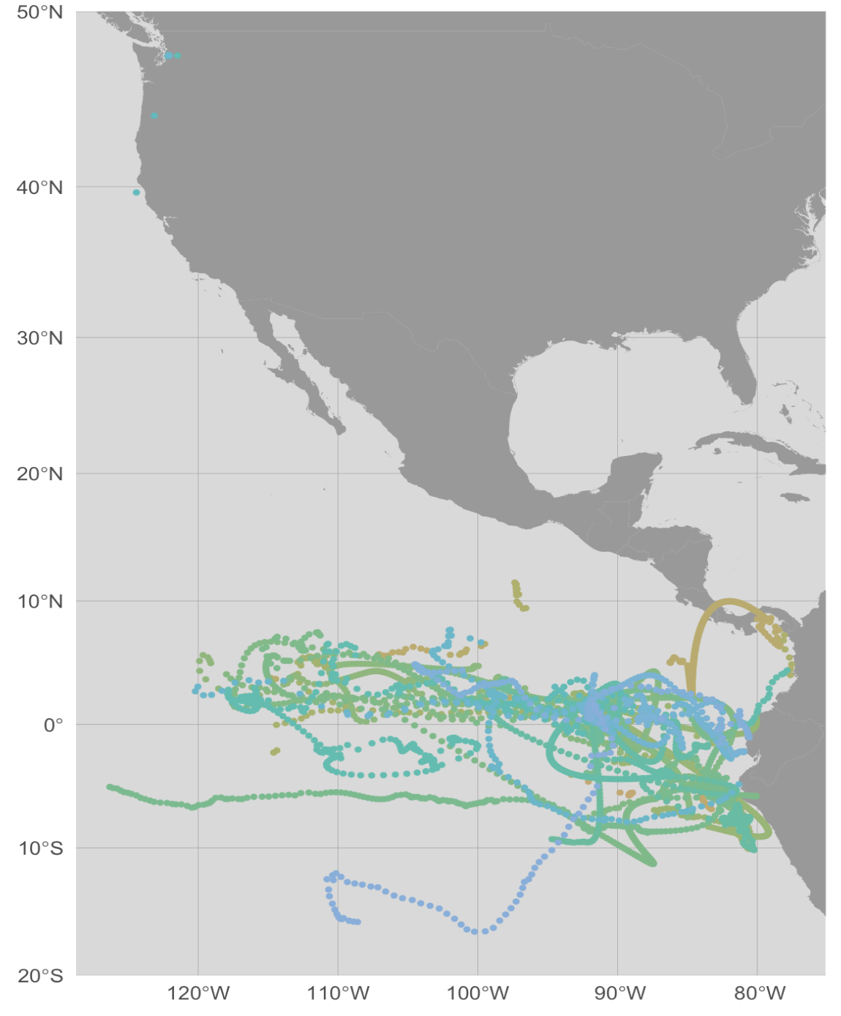
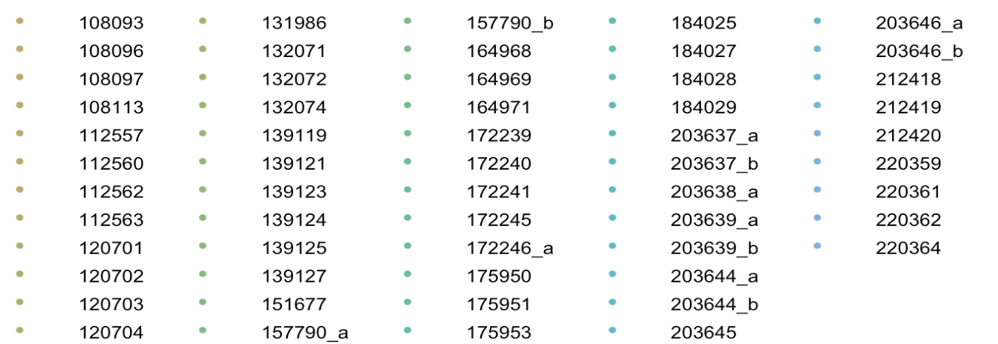
Predicted Movement Tracks by Individual
Colors distinguish individual shark
Tracks are reconstructed at regular time-fixed 24-hour intervals using the Movement Persistence Model
Notes:
This figure shows the reconstructed movement tracks for individual sharks after fitting the movement persistence model. Each colour corresponds to a different individual, and tracks are reconstructed at regular 24-hour intervals using the movement persistence model.
One immediate feature is that most reconstructed tracks are concentrated in the eastern tropical Pacific region, with relatively limited movement into higher latitudes. This spatial concentration is consistent across individuals and provides a useful reference for interpreting later persistence patterns.
During this reconstruction step, we noticed that for a small number of individuals, the predicted tracks crossed over the continent, which is biologically implausible for whale sharks. Upon further inspection, this behaviour was driven by very large temporal gaps between consecutive observations. In these cases, the model interpolated across long time intervals, leading to unrealistic trajectories.
To address this, we split the trajectories for these individuals into separate segments, treating them as independent track sections. These are labelled as sub_a and sub_b in the figure. This approach avoids imposing unsupported assumptions across long data gaps and results in reconstructed tracks that are more biologically plausible. In addition, individuals with fewer than 20 predicted locations were excluded from this visualization to ensure stable and interpretable results.

Slide 9
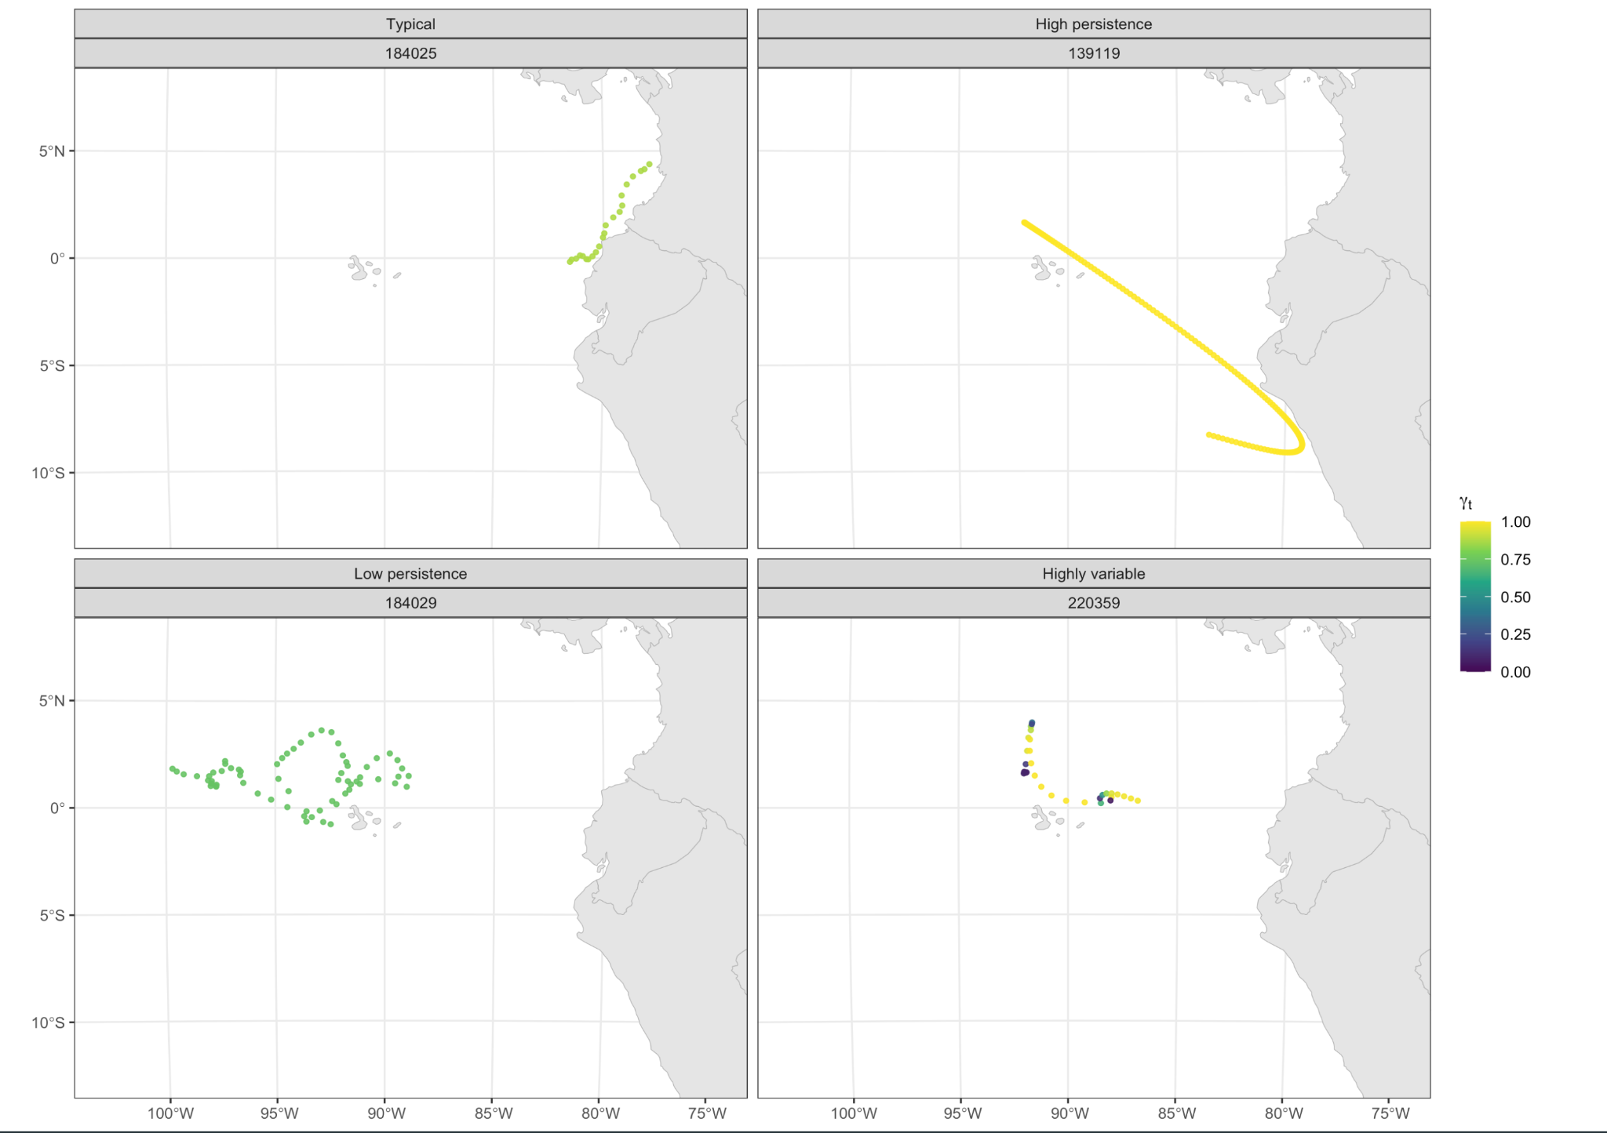
Representative tracks coloured by movement persistence
Notes:
This figure shows representative reconstructed tracks coloured by movement persistence, gamma_sub_t.
Each panel corresponds to an individual selected using quantile-based thresholds applied to individual-level summaries of the continuous movement persistence estimates.
Selection was based on the mean and temporal variability of gamma_sub_t​ over time, in order to illustrate a range of persistence patterns from relatively stable to highly variable movement.
Colours represent the value of gamma over time, with higher values indicating more persistent, directional movement and lower values indicating more tortuous movement.
In the high-persistence example, we see long, smooth trajectories with consistently high gamma values, whereas the low-persistence example shows more localized and irregular movement with lower gamma. The highly variable example illustrates frequent transitions between these two movement modes within the same individual. Here, we can see how changes in movement persistence correspond to differences in track geometry.

Slide 10
Current Stage
&
Next Steps
Notes:
/// NOTTTTTT MINEEEE/
For this presentation, we are building the move persistence model and looking for the results of the model.
…….
For our next presentation, we are performing the model diagnostic and how to choose difference time step for different sharks id and look for a smaller AIC when selecting the model.

Slide 11
Current Stage
State Space and Move Persistence Models fitted and validated
Latent movement tracks and time-varying persistence extracted
Preliminary visualizations completed
Next Steps
Explore alternative time steps for movement reconstruction
Assess individual-level heterogeneity and uncertainty
Incorporate environmental covariates into persistence modelling
Notes:
/

